Slide 1
Dynamic Semi-random Forest
Nikhil Alladi, Jacob Dipasupil, Petr Kisselev

Slide 2

Random Forest Algorithm
Ensemble Learning Algorithm
Bootstrapping
Random attribute subset selection
Aggregating

Slide 3
Limitations of Random Forest
Stochastic Nature
01
Run-to-run variance and inconsistent results
Small Dataset Performance
02
Although RF improves with higher sample sizes, this leads to unnecessary computational bloating for little improvement
Uniform random attribute selection
03
Assumes all features are equally correlated with the class

Slide 4
Related Works
Wang et al.
Lifandali et al.
Abdellatif et al.
Recursive Feature Selection
Two Phase Model
Weighted Random Feature Selection
Notes:
JACOB

Slide 5
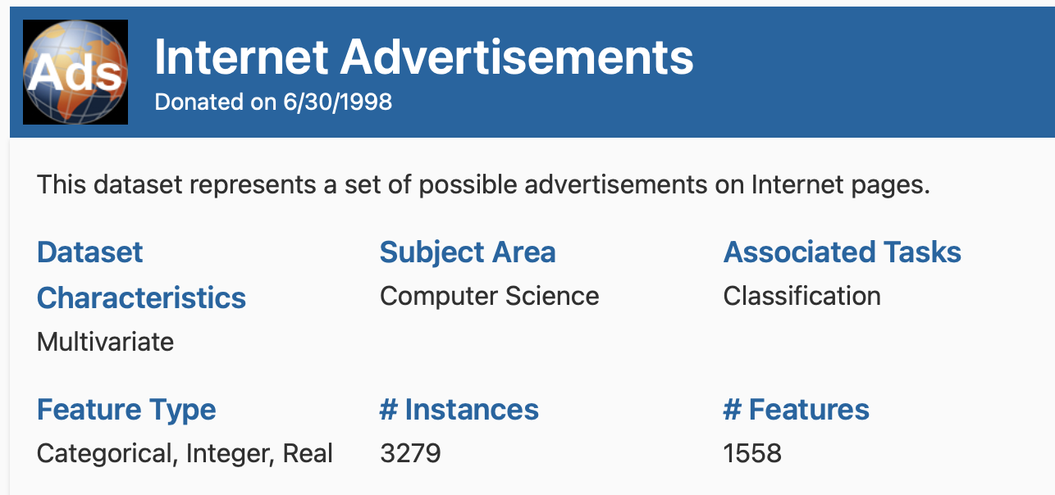

Datasets
Internet Advertisements + Jobs Dataset
Represents possible internet advertisement images
Task is to determine if the image is an internet advertisement based on the geometry of the image (aspect ratio), phrases in the URL, alt text, etc.
Chose for high dimensionality
Smaller dataset of synthetic job postings
1.62 million instances, 23 features
Task is to predict salary range
Obviously uncorrelated features (Job Portal, Contact)
Notes:
https://archive.ics.uci.edu/dataset/51/internet+advertisements
JACOB

Slide 6
Our Implementation
Dynamic Semi-Random Forest
Two Phase Model
Phase one: feature selection phase
Phase two: forest generation phase
Weighted Feature Selection
Weigh each feature based on the performance of decision trees containing those features

Slide 7
Testing Methodology
Main focus – Hyperparameter tuning
Difficult due to high running time
Balance of speed and accuracy necessary to complete in timely manner
More computational power or time could yield better values
Final values:
Depth: 15
Epoch Forest Size: 30
Attributes: standard square root of n

Slide 8
DSRF MODEL ARCHITECTURE
PHASE 1
PHASE 2
Update Feature Weights
Build Weighted Random Forest
x M
Choose features and Dataset Sample
x N
Same as traditional RF implementation with only difference being feature random selection being weighted with produce feature weight distribution from PHASE 1.
Build Decision Tree
Store Performance
Build Decision Tree
Accuracy passed through an easing function (x³ in our case).
Standard implementation

Slide 9
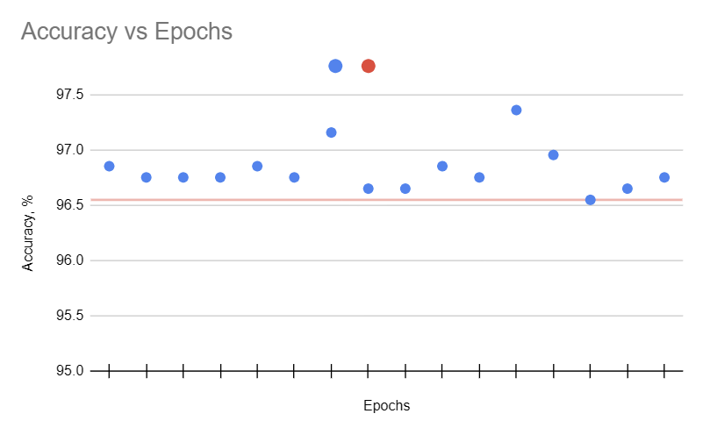
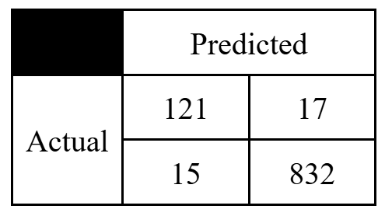
RESULTS
Our peak accuracy was that of about 97%, a strong performance.
Must be compared to 96% accuracy of standard Random Forest algorithm.
4% -> 3% missed is actually a 25% improvement!
Precision: 0.877
Recall: 0.89
Empirically found that 11 epochs had the highest performance.
Performance not well correlated with number of epochs trained – suggests fundamental algorithmic issue

Slide 10
Discussion
What limited performance?
Small room for improvement
Getting stuck in local minimums - once attribute better than others it will receive an abundance of attention
Grouped attributes receiving same score (no matter actual impact within Decision Tree)

Slide 11
Future Work
Explore getting relative performances from Decision Tree level to leverage full scoring system
Incorporate more advanced metrics for feature scoring
More challenging dataset choice to have more room for improvement
Improve efficiency to speed up runtime

Slide 12
Conclusion
Good
Conceptually strong - needs deeper analysis
Noticeable, albeit small, relative improvement
Bad
Small absolute improvement
Run time
Local min issue

Slide 13
References
[1] Data source website: https://archive.ics.uci.edu/dataset/51/internet+advertisements
[2] https://www.sciencedirect.com/science/article/abs/pii/S0167865512001274
[3] https://www.sciencedirect.com/science/article/pii/S0957417423020511
[4] https://www.sciencedirect.com/science/article/pii/S1877050923006415
[5] https://onlinelibrary.wiley.com/doi/full/10.1155/2021/5529389
[6] https://ieeexplore.ieee.org/abstract/document/9802107

Slide 14
Any questions?

